Slide 1


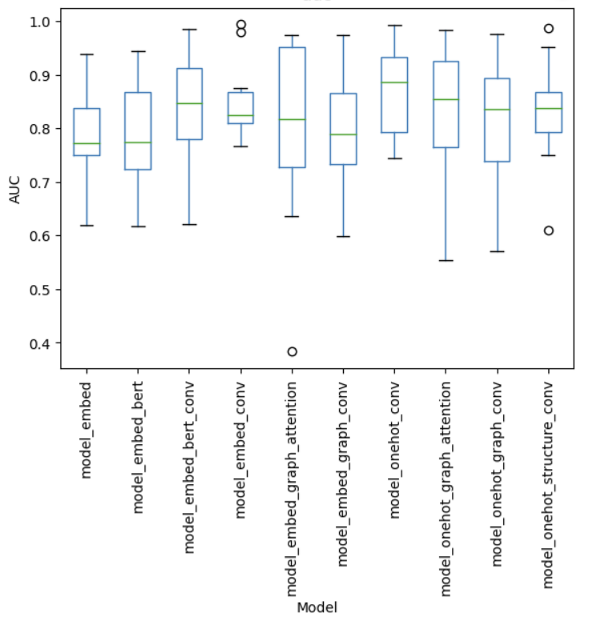
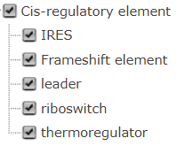
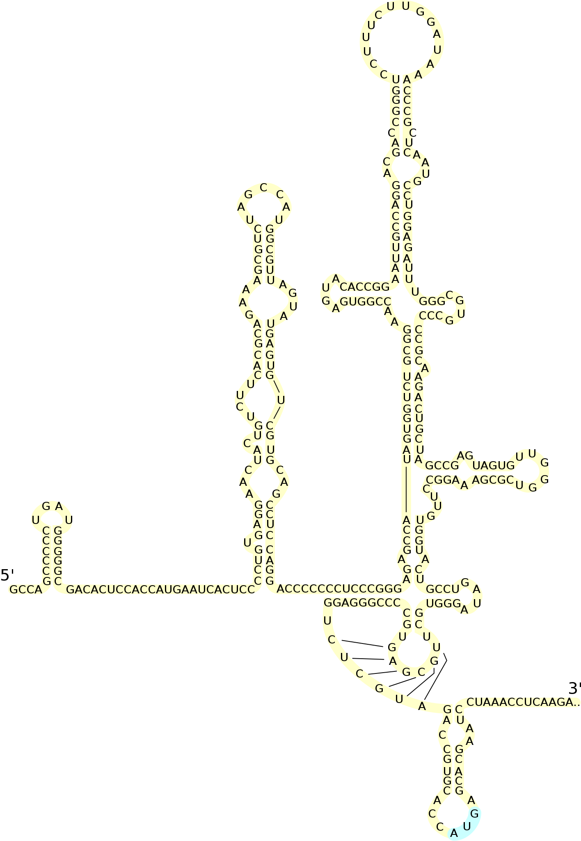
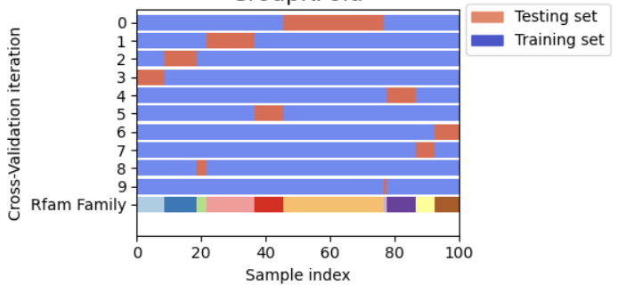
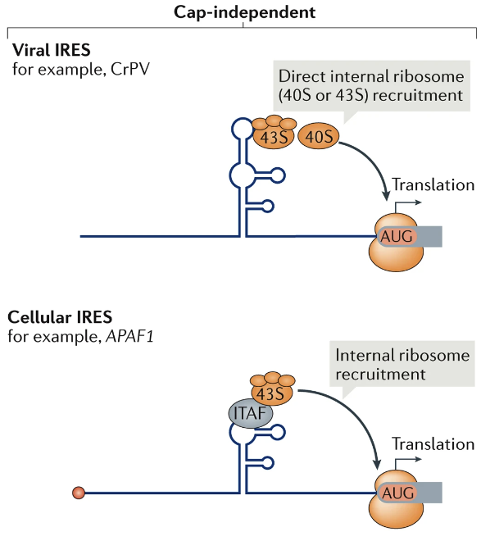
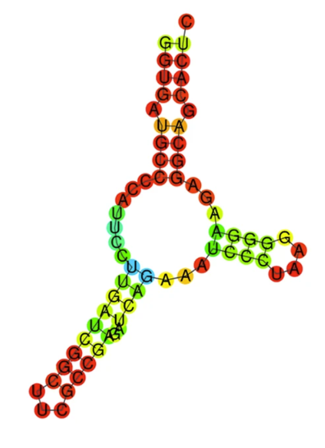
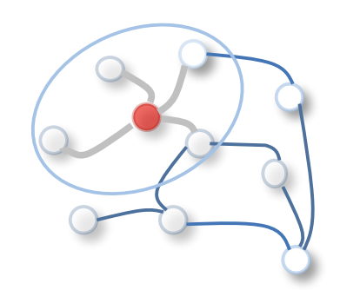
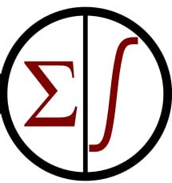
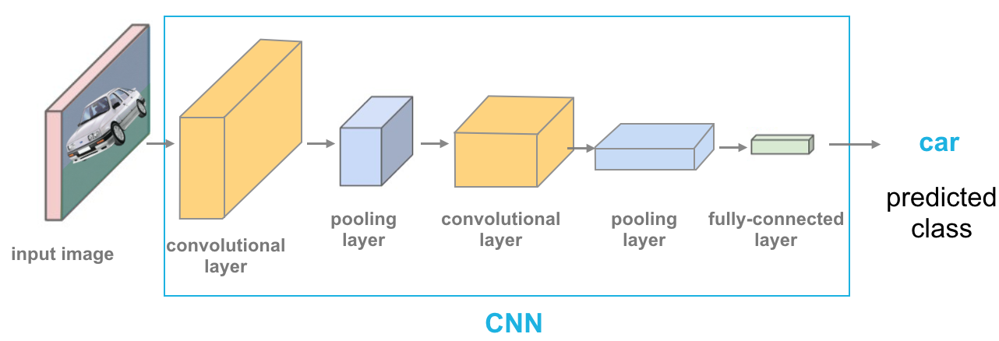
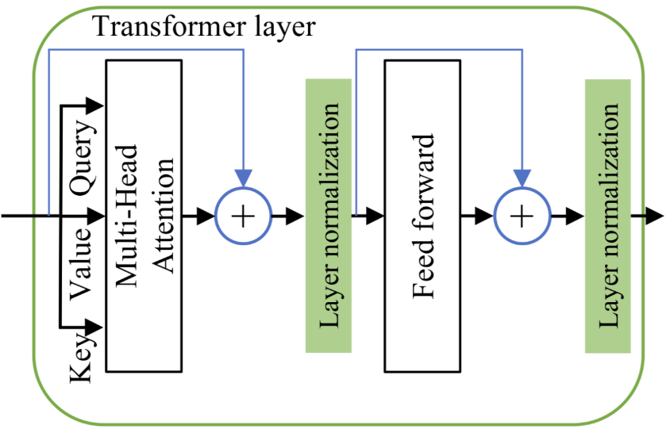


Prediction of Full-Length Internal Ribosome Entry Sites (IRES) Using Deep Learning
Yupeng Li
RVAC Medicines Inc, Waltham, MA, USA
Introduction
Internal ribosome entry sites (IRESs) are RNA elements that can recruit ribosomes and allow cap-independent translation [1]. Analyzing IRES is important for advancing our understanding of many biological functions and developing RNA-based therapeutics.
A few machine learning models have been developed to identify IRES and related sequence and structure features using a data-driven approach. However, it is noteworthy that most models were trained using the same oligonucleotide library with 550k 174-nt length sequences, many of which were truncated IRESs.
Since a full-length IRES is critical for strong translation [2], we focused on developing a deep-learning model to identify full-length IRES.
Data Processing
Results
Conclusions
A simple convolutional neural network (CNN) model with the one-hot encoding of the nucleotides as input outperformed many other complicated architectures.
On average, the CNN model achieved 0.87 AUC and 0.39 AUPRC in the 10-fold cross-validation.
With the highly accurate classification model, we can further identify motifs that are important to the IRES function and design new IRESs.
References
Leppek, Kathrin, Rhiju Das, and Maria Barna. Nature Reviews Molecular Cell Biology 19.3 (2018): 158-174.
Chen, Robert, et al. Nature Biotechnology 41.2 (2023): 262-272.
Wu, Zonghan, et al. IEEE Transactions on Neural Networks and Learning Systems 32.1 (2020): 4-24.
Randomly remove 1-3nt from either end of the original sequence, assuming the IRES function is not impacted
Data were split by RNA families to avoid data leakage due to the sequence similarity within a family
Positive Samples
1,433 sequences with length > 100nt
Negative Samples
166,138 sequences with length > 100nt
2 nt in 5’ end are removed in one sample
Download Data from Rfam
Data Augmentation of Positive Samples
Data Splitting for
Cross-Validation
Deep Learning Models
Name | Encoding layer | Model layers
embed | embedding | fully connected (FC) layer only
embed_bert | embedding | BERT + flatten + FC
embed_bert_conv | embedding | BERT + convolution +FC
embed_conv | embedding | convolution + FC
embed_graph_attention | embedding + secondary structure | graph attention + average pooling + FC
embed_graph_conv | embedding + secondary structure | graph convolution + average pooling + FC
onehot_conv | one-hot encoding | convolution + FC
onehot_graph_attention | one-hot encoding + secondary structure | graph attention + average pooling + FC
onehot_graph_conv | one-hot encoding | graph convolution + average pooling + FC
onehot_structure_conv | one-hot encoding + secondary structure one-hot encoding | convolution + FC
Graph Models
…
Encoding Layer
Secondary Structure Graph
Graph Convolution or Attention [3].
(Edges come from the secondary structure)
Other Models
One-Hot Encoding
Embedding
Sigmoid Output
(Binary Classification)
A
C
G
U
C
C
G
U
1 | 0 | 0 | 0
0 | 1 | 0 | 0
0 | 0 | 1 | 0
0 | 0 | 0 | 1
0 | 1 | 0 | 0
0 | 1 | 0 | 0
0 | 0 | 0 | 0
0 | 0 | 0 | 1
(
(
(
.
.
)
)
)
1 | 0 | 0
1 | 0 | 0
1 | 0 | 0
0 | 1 | 0
0 | 1 | 0
0 | 0 | 1
0 | 0 | 1
0 | 0 | 1
A
C
G
U
C
C
G
U
…
Convolution
…
Primary Sequence
Secondary Structure
Numeric values learned by the models
Encoding Layer
BERT (Transformer Encoder)
Concatenate the encoded matrices if the secondary structure is used
Fifth Annual RNA Therapeutics: From Concept to Clinic
Worcester, MA, June 21 - 23, 2023
Presented and Sponsored by RVAC Medicines

